Slide 1
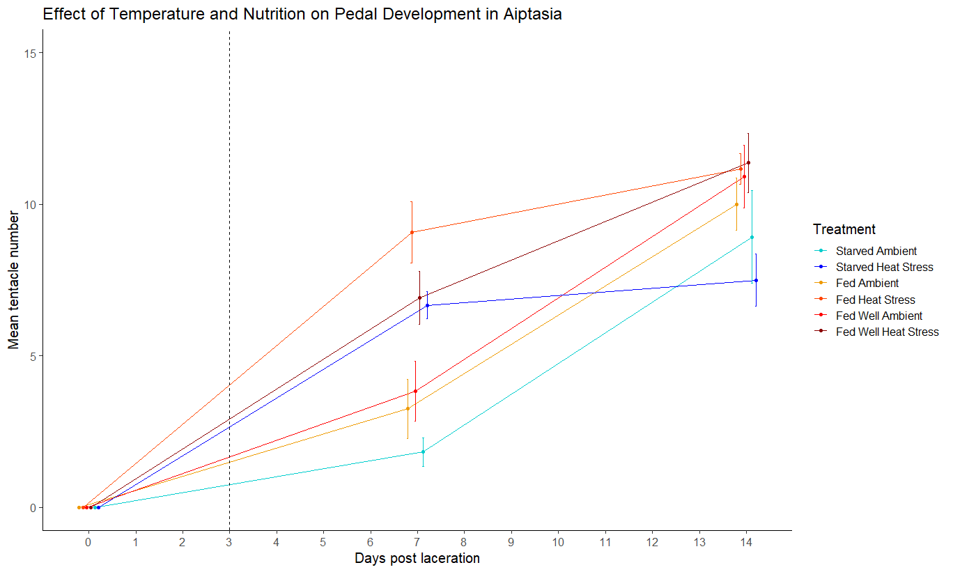

Slide 2
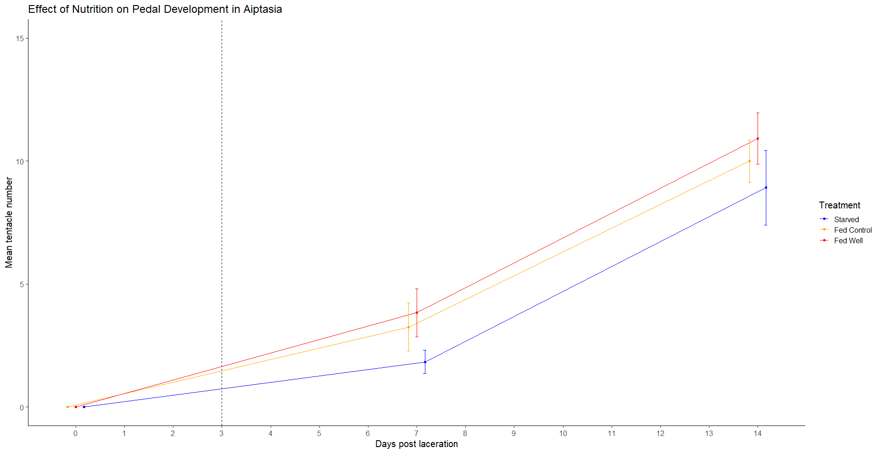
***

Slide 3
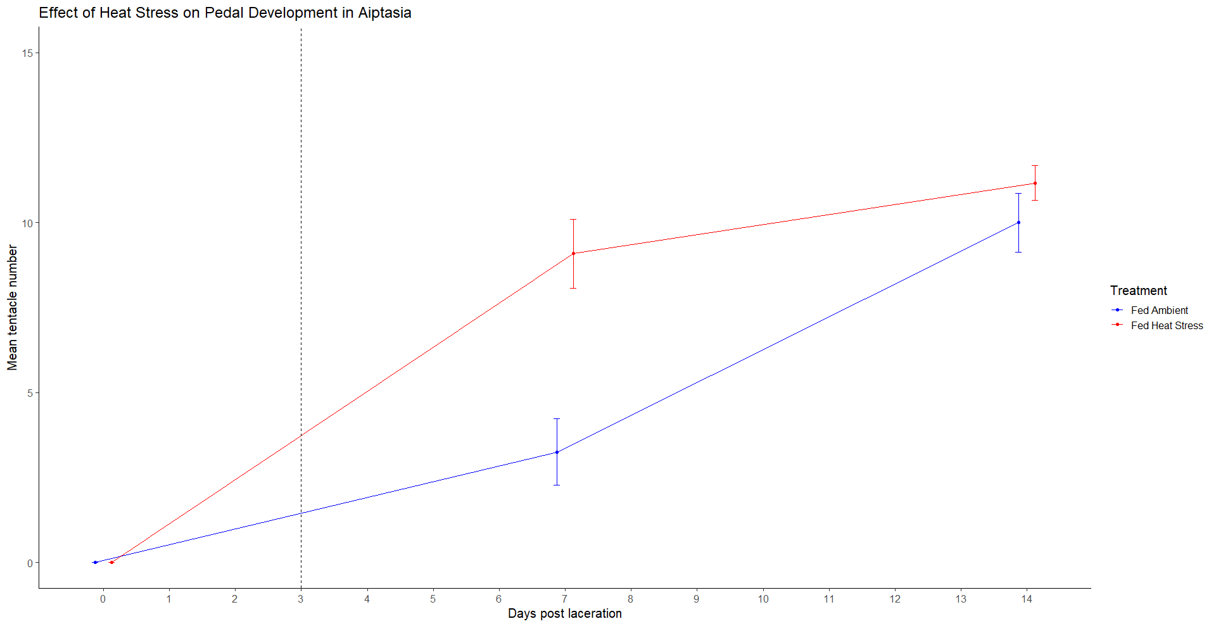

Slide 4
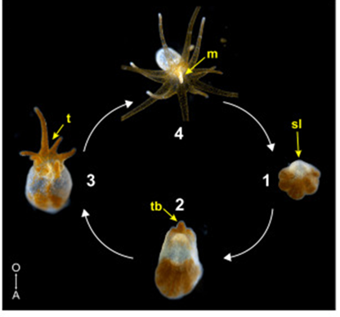
Effect of Heat Stress, Symbiosis and Clonal Line on Pedal Lacerate Tentacle Development
Jun Cai, Val Sawiccy, Students of Zoology 362 Invertebrate Biology, Kali Sivula, Riley Jones, Kathryn Hampton-Wonder, Sofia Blair, Nate Kirk, Virginia Weis

Slide 5
Research questions
What are the effects of heat stress, symbiosis and clonal line on pedal development as measured by tentacle numbers and overall size?
Hypothesis:
Heat stress will increase the rate of tentacles development in pedal lacerates from 0-7 days but will cease to have any significant effects by day 14
Aposymbiotic lacerates will have a higher rate of tentacle development up to 7 days post laceration and symbiotic lacerates will develop faster after 7 days (Jason’s results)
Clonal line should not have no significant effect on tentacle development
Do symbiotic pedal lacerates bleach under heat stress?
Hypothesis: Pedal lacerates will bleach and lose symbionts inherited from parents in heat stress
Do the symbionts of symbiotic pedal lacerates proliferate under ambient and heat stress conditions?
Hypothesis: Symbionts of pedal lacerates would proliferate under ambient conditions and bleach under heat stress conditions.

Slide 6
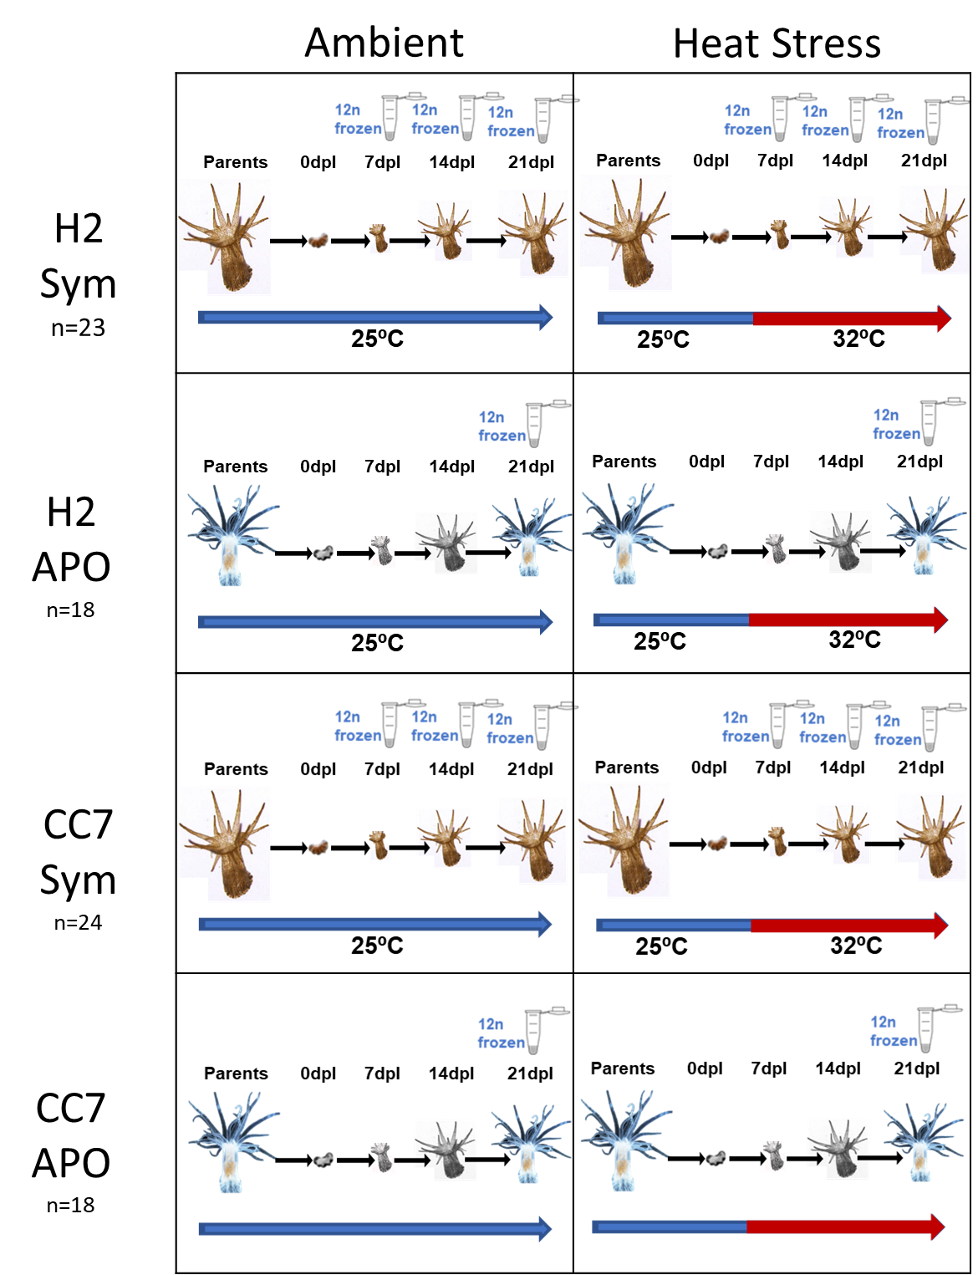
Experimental Design
Eight treatment groups
2 Clonal lines (CC7 and H2)
Aposymbiotic vs Symbiotic state
Ambient vs Heat Stress (32 C at 3dpl)
Measuring tentacle number, size (imaging), symbiont level (12 samples preserved per treatment)
Sample size:
N = 83* adult anemones and 309 lacerates
Adult breakdown: 18HA, 18CA, 24CS, 23HS
Lacerate breakdown: 53HA, 51CA, 107CS, 98HS^
4-6 lacerates generate per adults
*108 adults were plates at start of experiment
^ 49HA, 39CA, 50CS, 82HS surviving after 7dpl

Slide 8
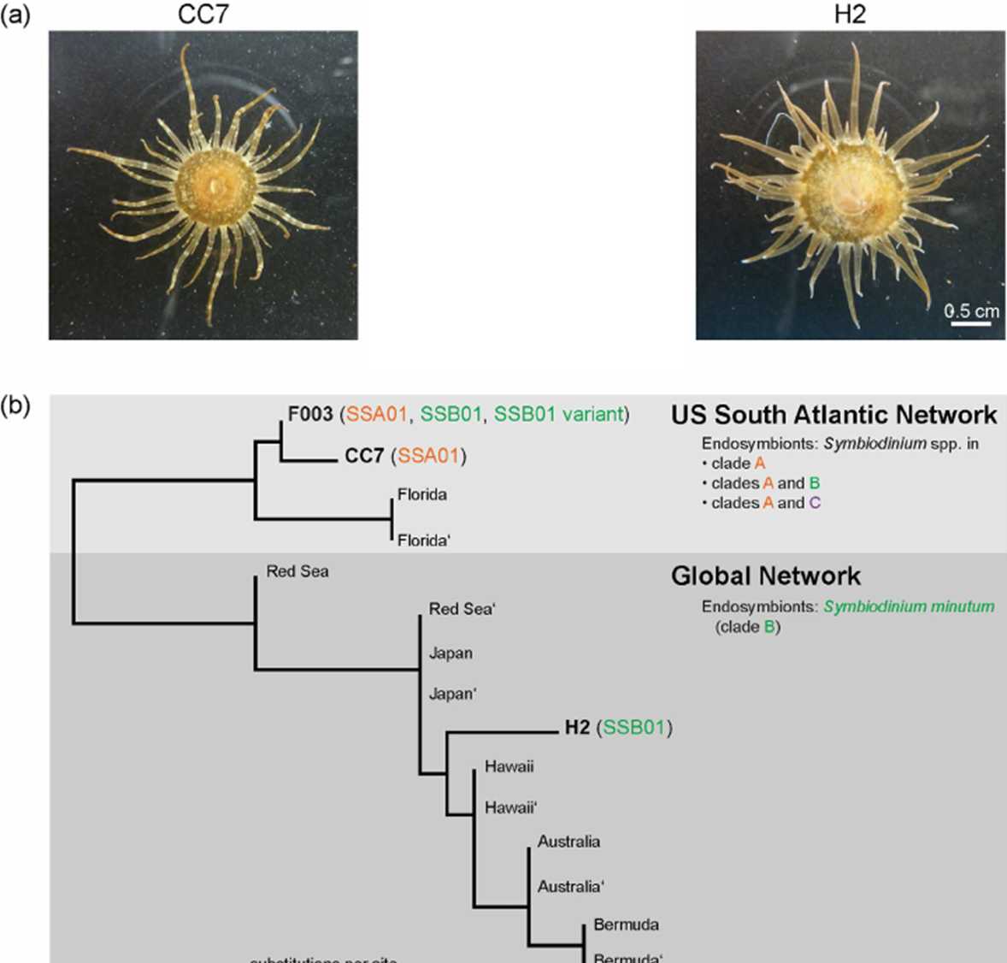
Update Taxonomy
SSA01 - Symbiodinium linucheae
SSB01 - Breviolum minutum
Image Source: Grawunder, D., Hambleton, E., Bucher, M. et al. 2015. Induction of Gametogenesis in the Cnidarian Endosymbiosis Model Aiptasia sp.. Sci Rep 5, 15677.
Notes:
“The founder animals for male line CC7²⁶ and female line F003 (courtesy of the John Pringle lab) were originally collected by Carolina Biological Supply Company (#162865; Burlington, USA) from an area approximately centered on Wilmington, North Carolina, USA. The founder animal for line H2 was collected off Coconut Island, Hawaii²².”

Slide 9
Lacerate Sample Size Breakdown
 | H2 Symbiotic |  | H2 Aposymbiotic |  | CC7 Symbiotic |  | CC7 Aposymbiotic
 | Ambient | Heat Stress | Ambient | Heat Stress | Ambient | Heat Stress | Ambient | Heat Stress
Sample Size at 0dpl How many we thought we generated | 48 | 50 | 27 | 26 | 51 | 56 | 26 | 25
Sample Size at 7dpl | 41 | 41 | 23 | 26 | 29 | 21 | 19 | 20
Sample Size at 14dpl | 31 | 29 | 23 | 26 | 23 | 15 | 19 | 20
Sample Size at 21dpl | 20 | 17 | 23 | 26 | 23 | 15 | 18 | 20

Slide 10
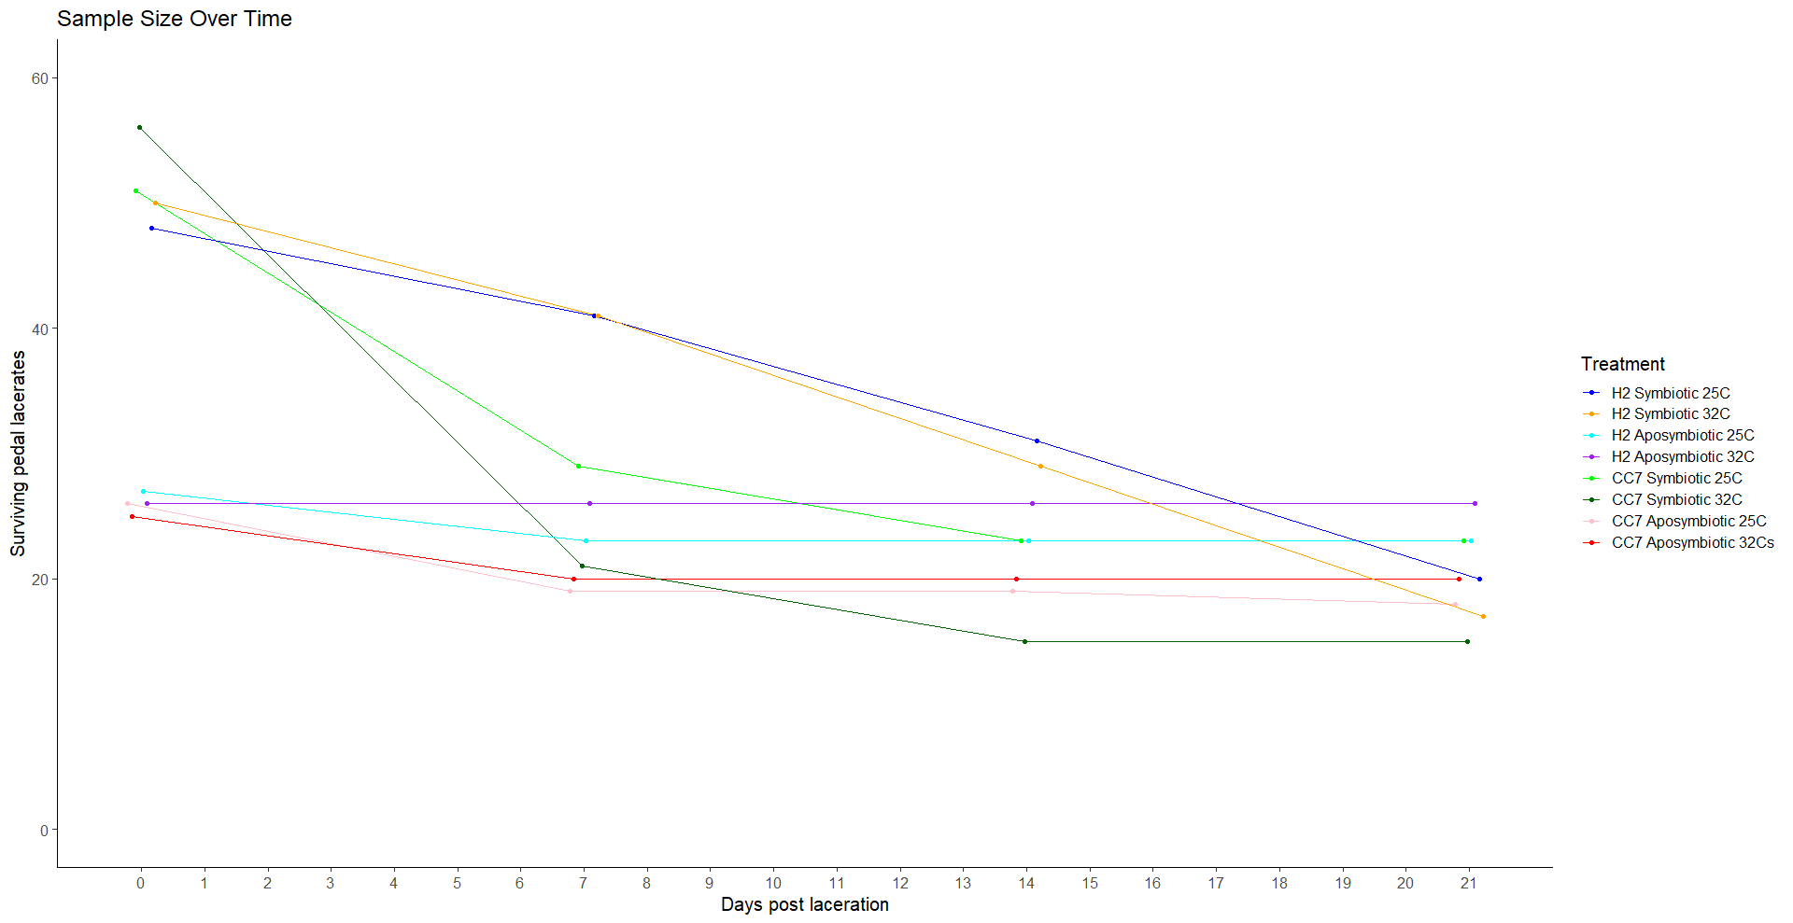

Slide 11
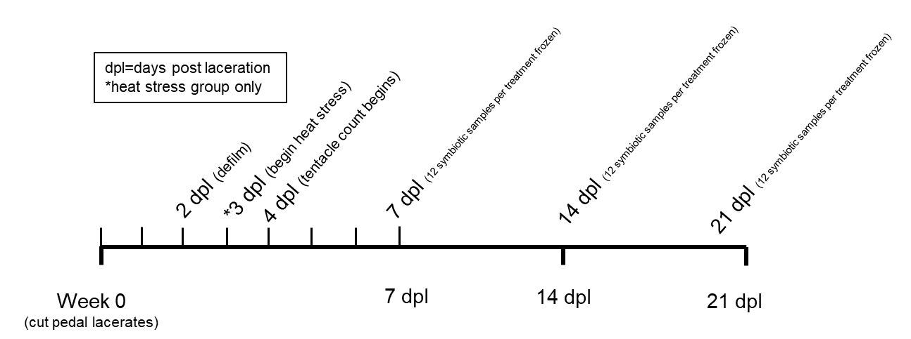
Heat Stress at 32°C

Slide 12
Results: Comparing all the Treatment Groups
***

Slide 13
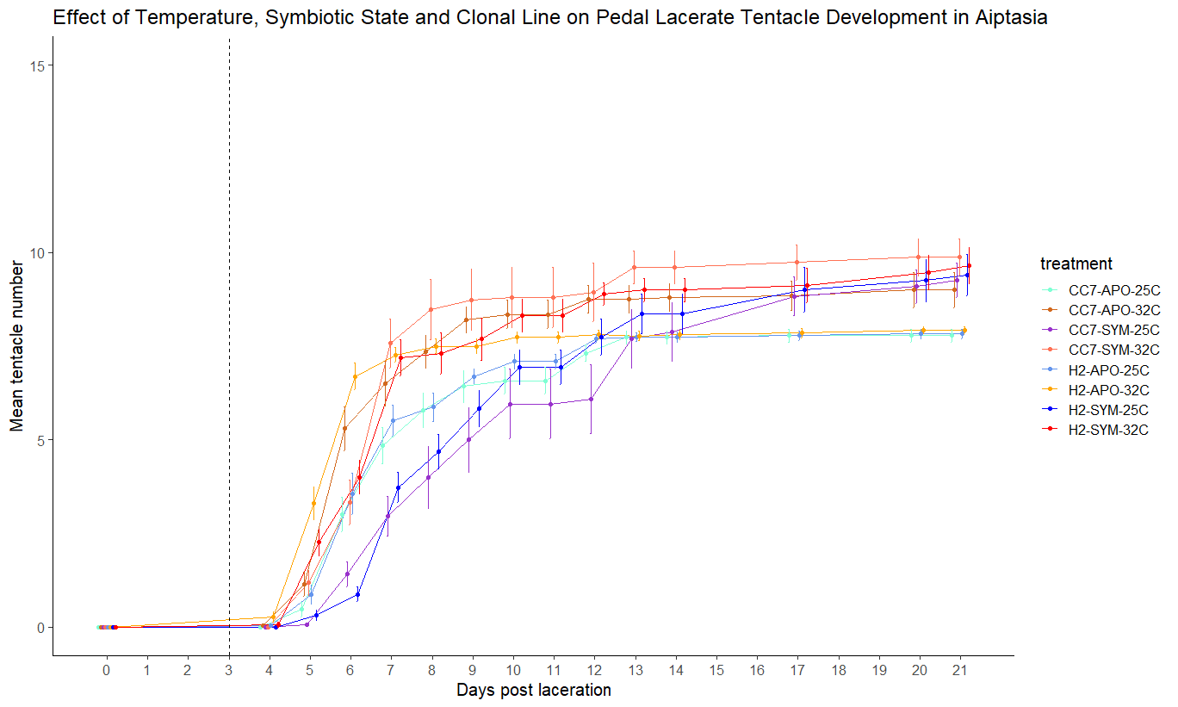

Slide 14
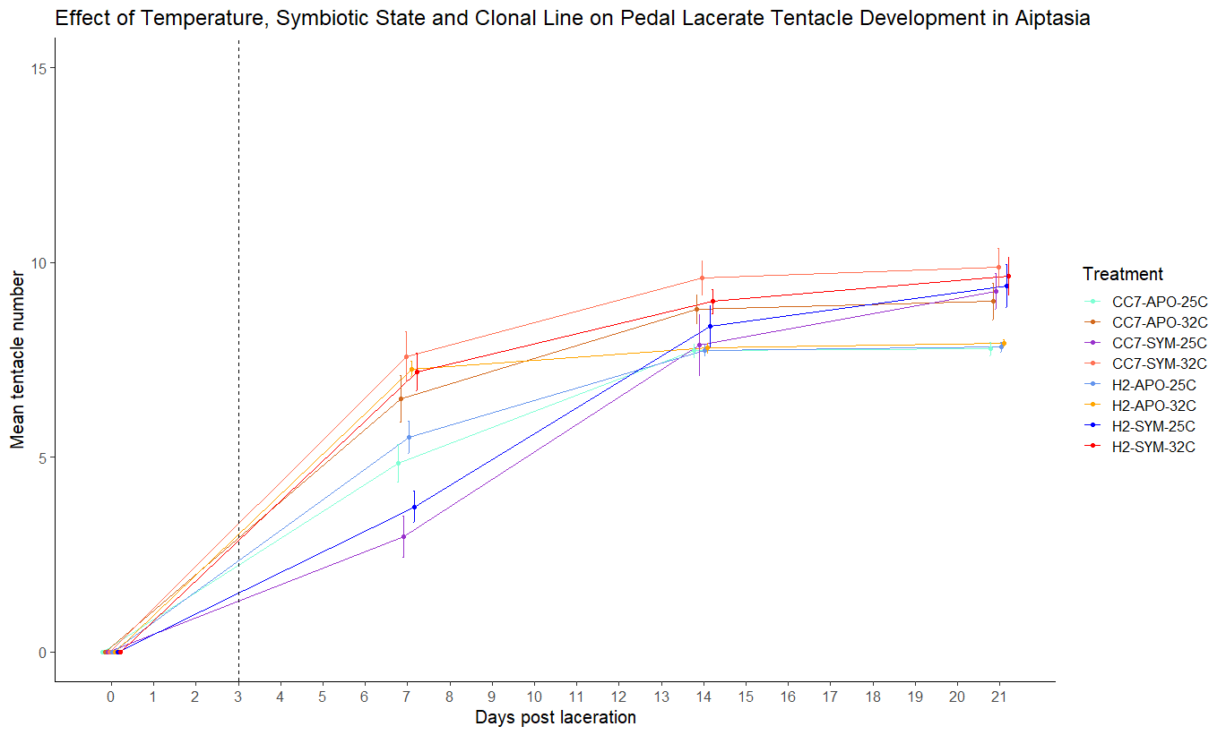

Slide 15
Effect of Ambient vs Heat Stress

Slide 16
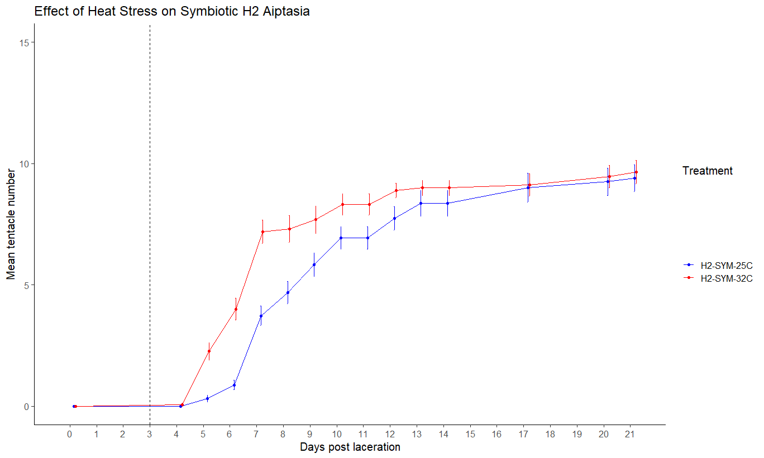
*
***

Slide 17
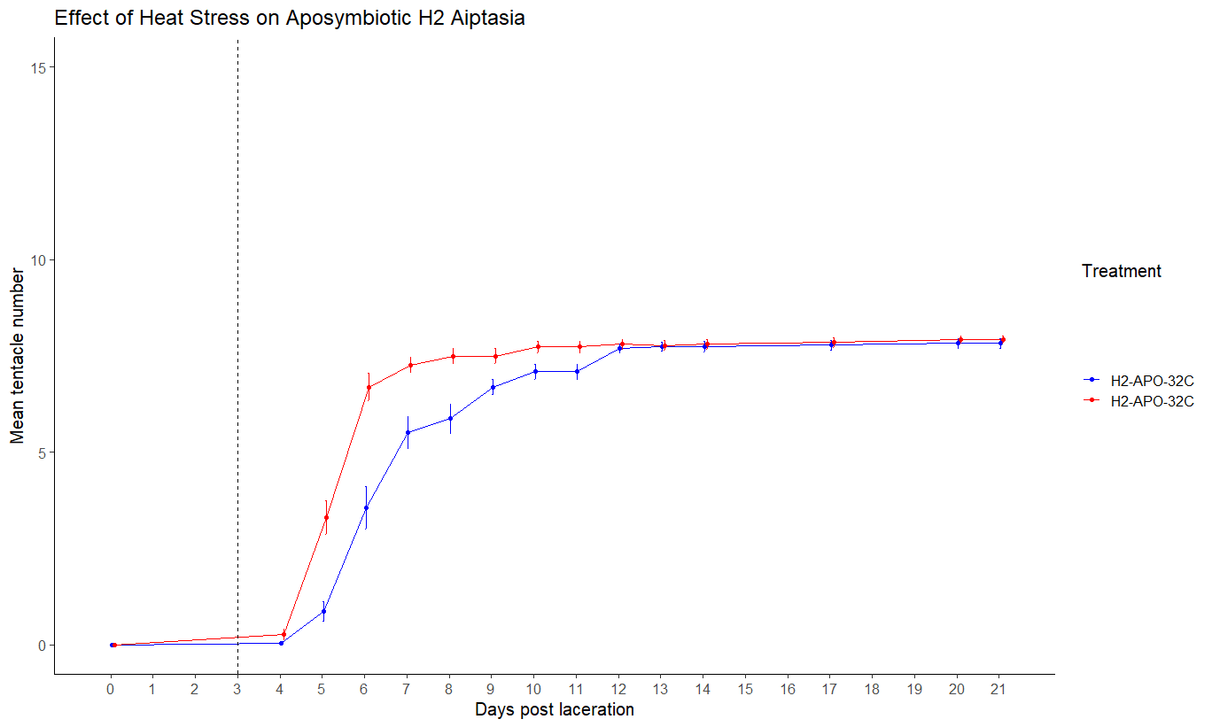
**
***

Slide 18
Compared to Spring Z362 CURE Project
***

Slide 19
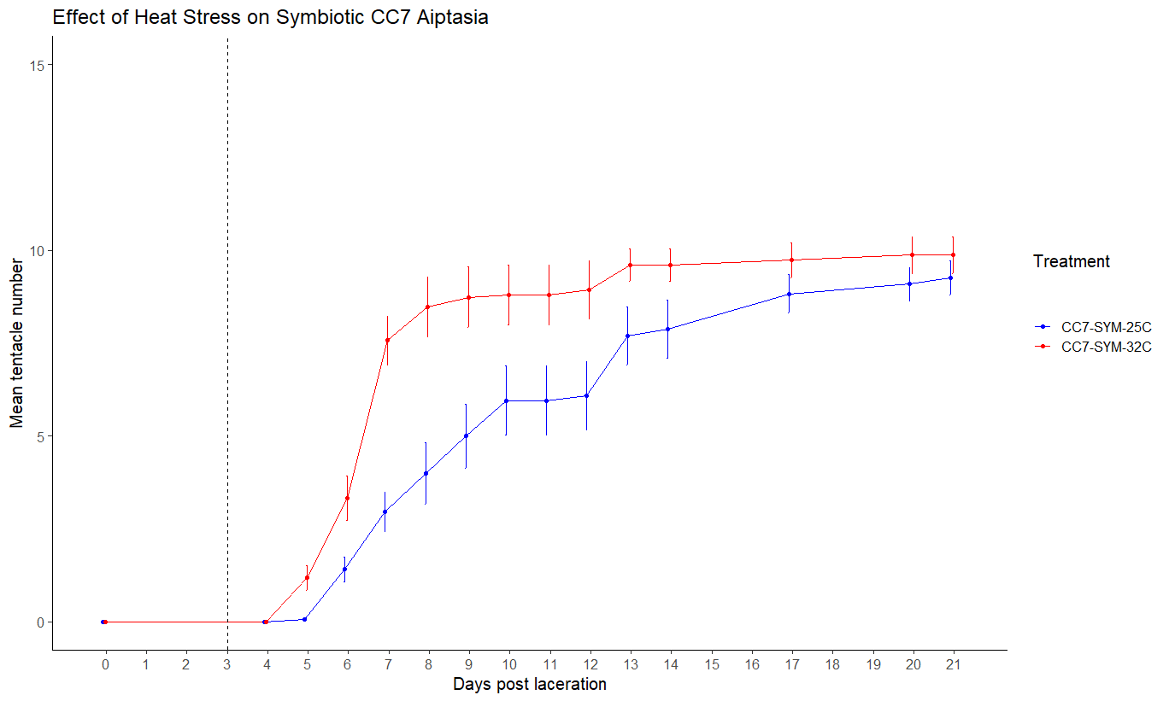
***
**
*
**
***

Slide 20
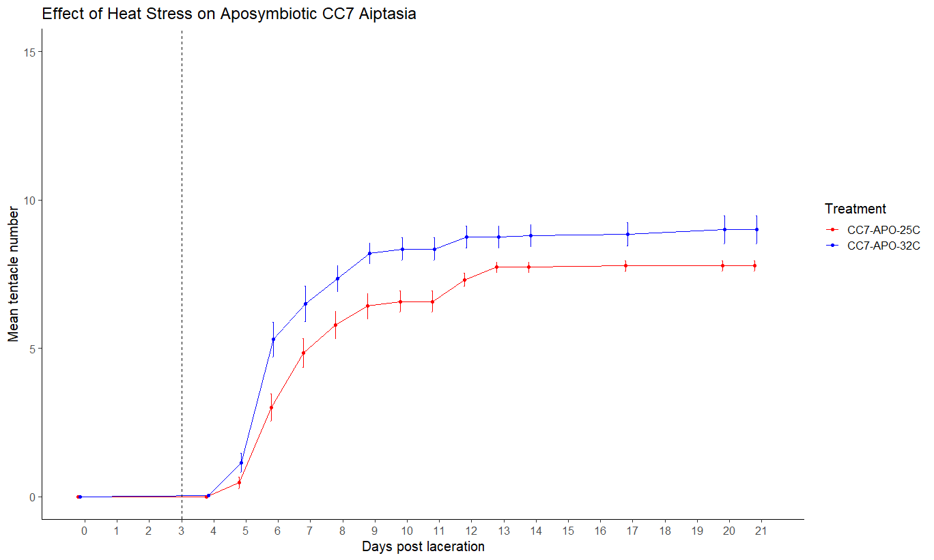
**
*
*
**

Slide 21
Effect of Symbiotic State

Slide 22
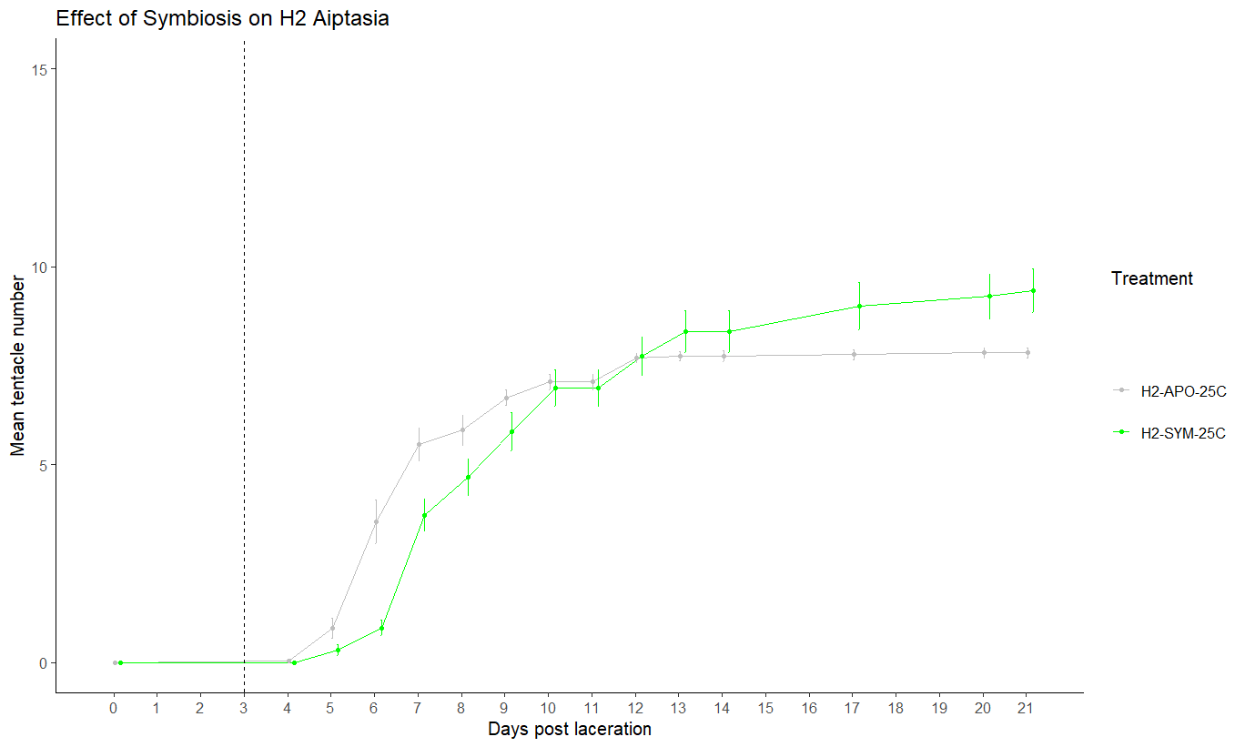
*
**
**
***
*

Slide 23
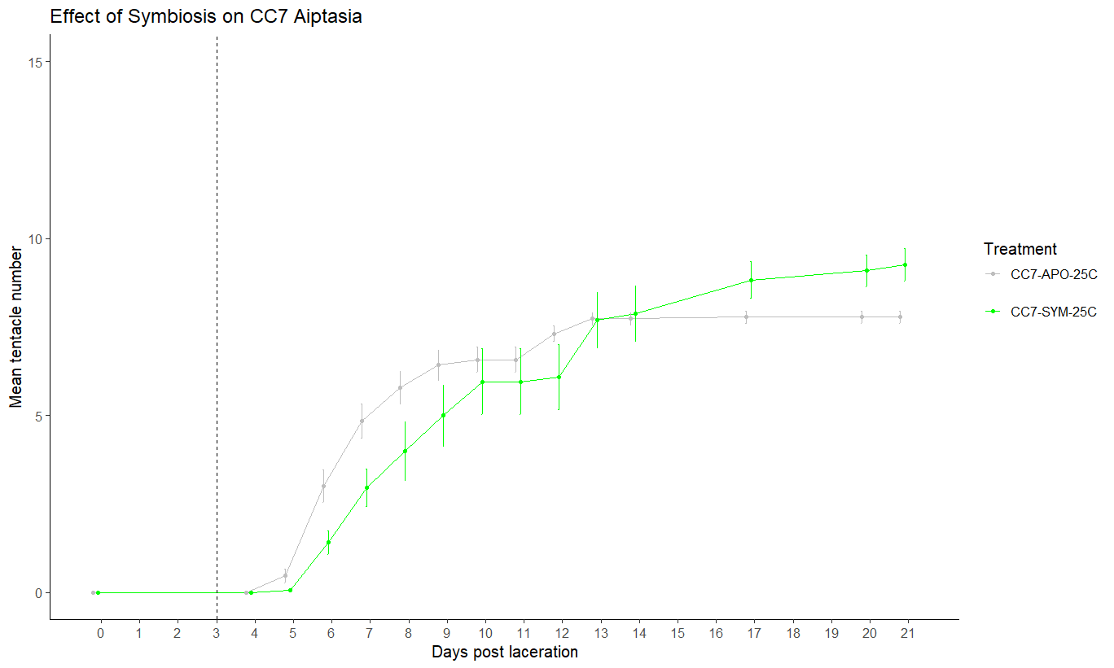
*
*
**
*

Slide 24
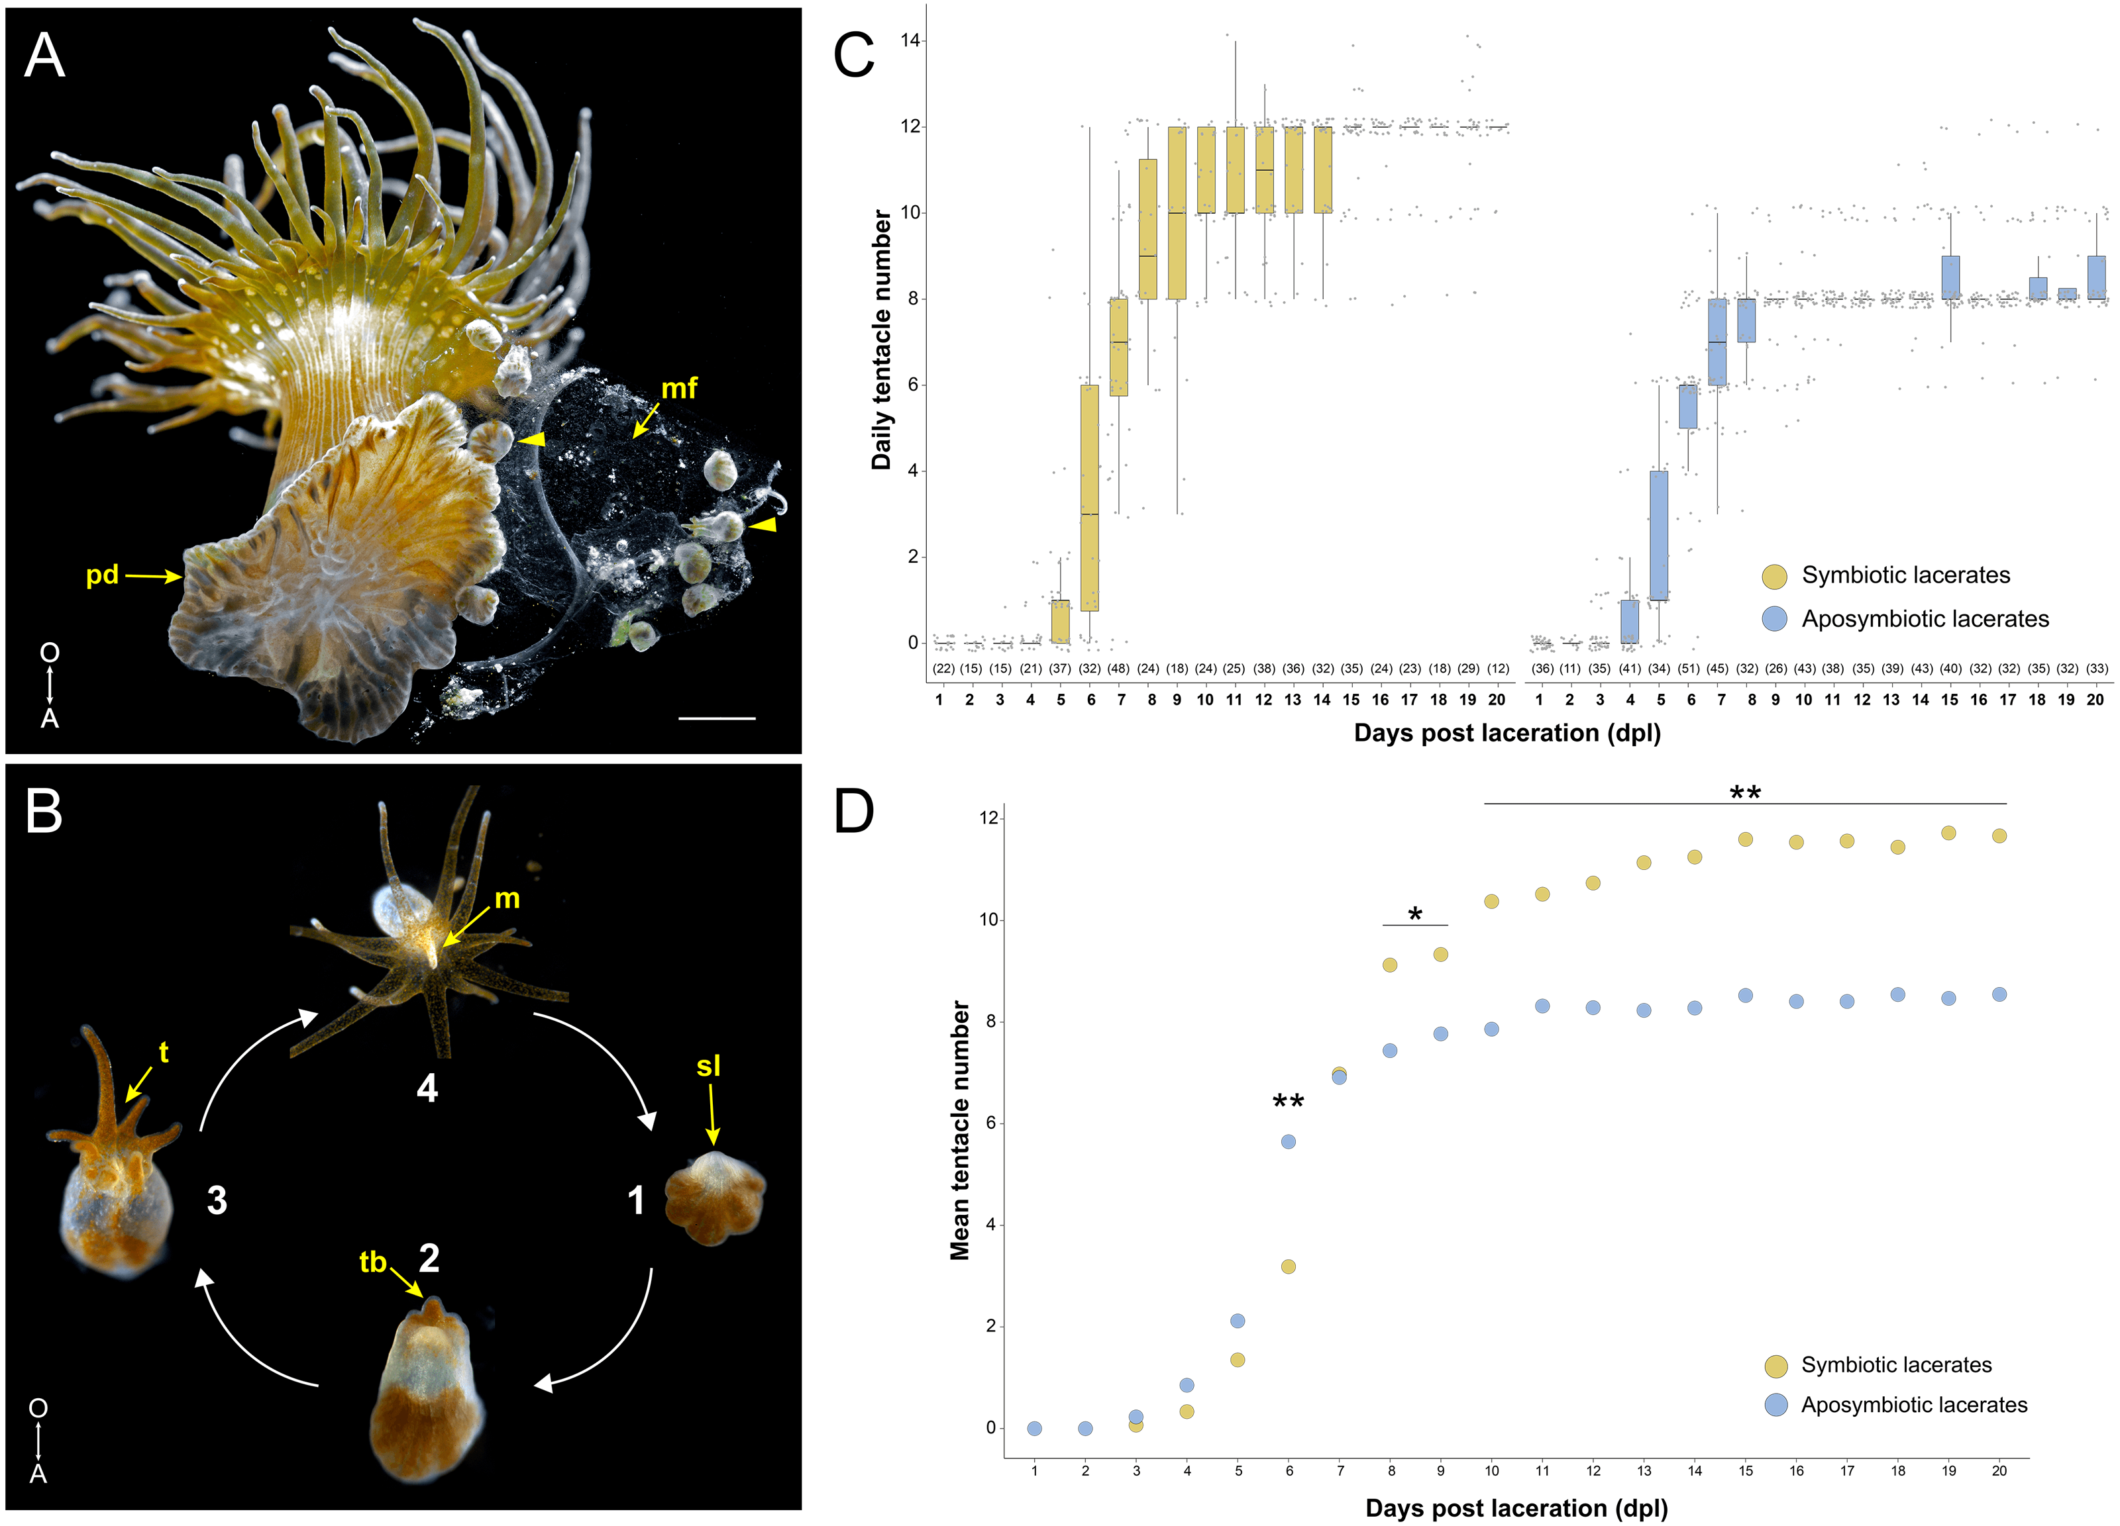

Slide 25
Effect of Clonal Line

Slide 26
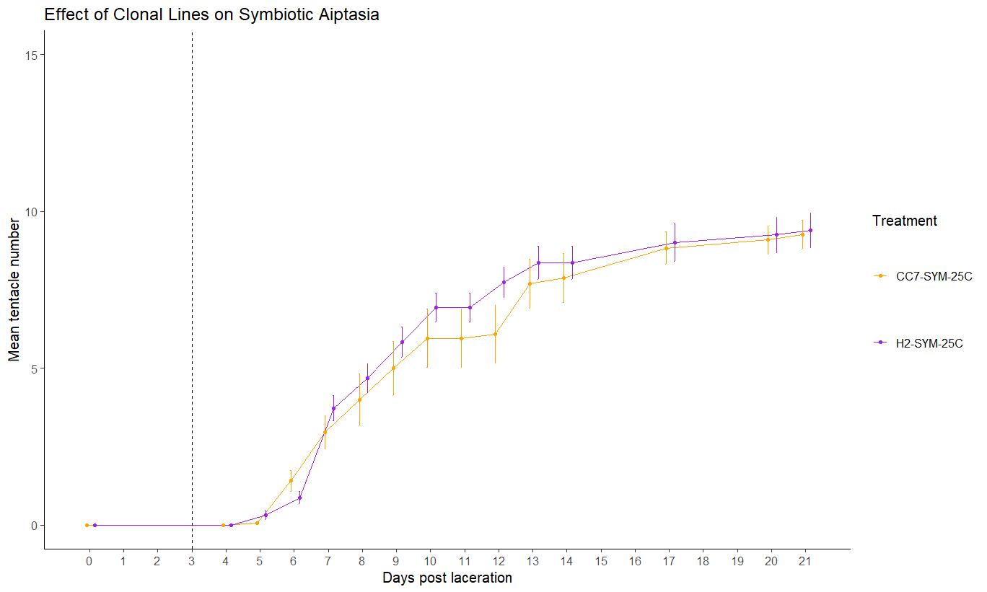

Slide 27
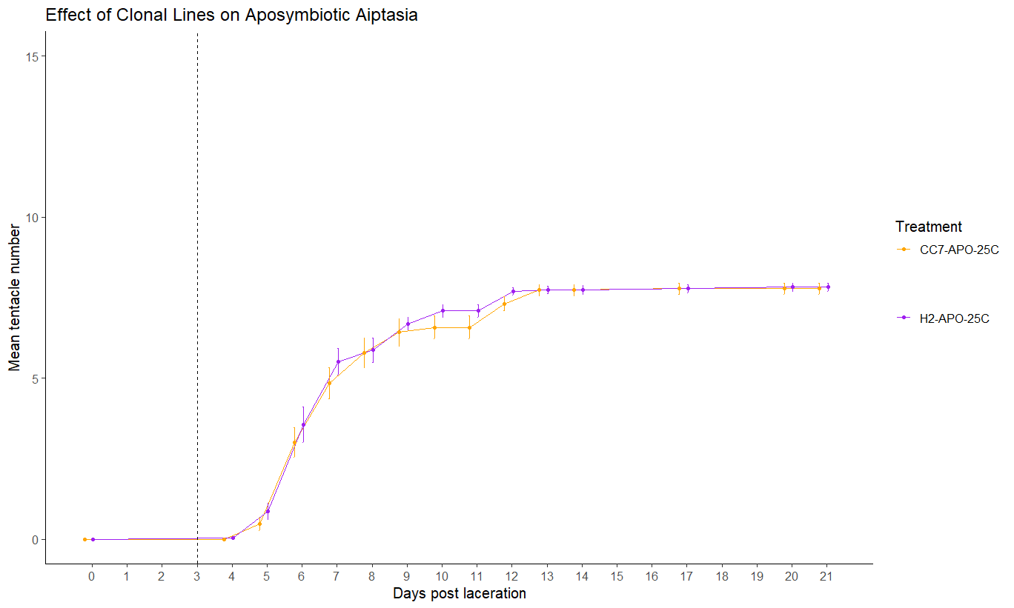

Slide 28
Results Summarized
What are the effects of heat stress, symbiosis and clonal line on pedal development as measured by tentacle numbers and overall size?
Results:
Heat stress increases tentacle development between 5 to 12 days post laceration and plateaus after 13 days in all treatment group except aposymbiotic CC7.
Rate of tentacle development are higher in aposymbiotic lacerates at early stages of development (5-7 dpl) and favors symbiotic lacerates at later stages (after 7 dpl)
Clonal line should not have no significant effect on tentacle development
Do symbiotic pedal lacerates bleach under heat stress?
TBD
Do the symbionts of symbiotic pedal lacerates proliferate under ambient and heat stress conditions?
TBD

Slide 29
Further Experiments with Acclimation
Need to analyze frozen samples from this project and CURE for symbiont levels
Countess vs Hemocytometer
Need to go through images of lacerates
Replicating CC7 data with more successful numbers
Maybe CC7 are harder to lacerate??
Finding the thermal threshold for lacerates vs adults
When does increased temperature become a detriment toward tentacle development?
Can thermal tolerated adults pass on acclimation phenotypes to asexual lacerates?

